Slide 1
Things needed for homework on ch 15 and 16
Relationship between luminosity, radius, and temperature
Flux: the light that gets to us, another 1/r² law
Parallax
Magnitudes and brightness

Slide 2
So many announcements!
Midterm 2 will be next Tuesday, 10/30
Thursday I’ll give a study guide/brief in-class review after chapter 18
This test will be a little different, hopefully in a good way
Extra credit (5% toward final grade) Three College Observatory visit nights just for A235 students:
Thursday, 11/1
Sunday, 11/4
Monday, 11/5
Thursday, 11/8
Only if clear!! Observatory phone number (336-334-5700) will have on/off announcement by 5:30pm those dates
We will arrange carpools in Petty main foyer at 6pm (~40min drive to TCO). I can only take 3- volunteers with cars much appreciated!
Notes:
Dress warmly, no heat at observatory!

Slide 3
Poof…
Notes:
Where we left off last time!
Could be many poofs, not just one big one (asymmetries in the PN)
Helix nebula (left)
https://www.spaceanswers.com/news/planetary-nebulae-get-much-more-meaningful-physical-appearance/

Slide 4
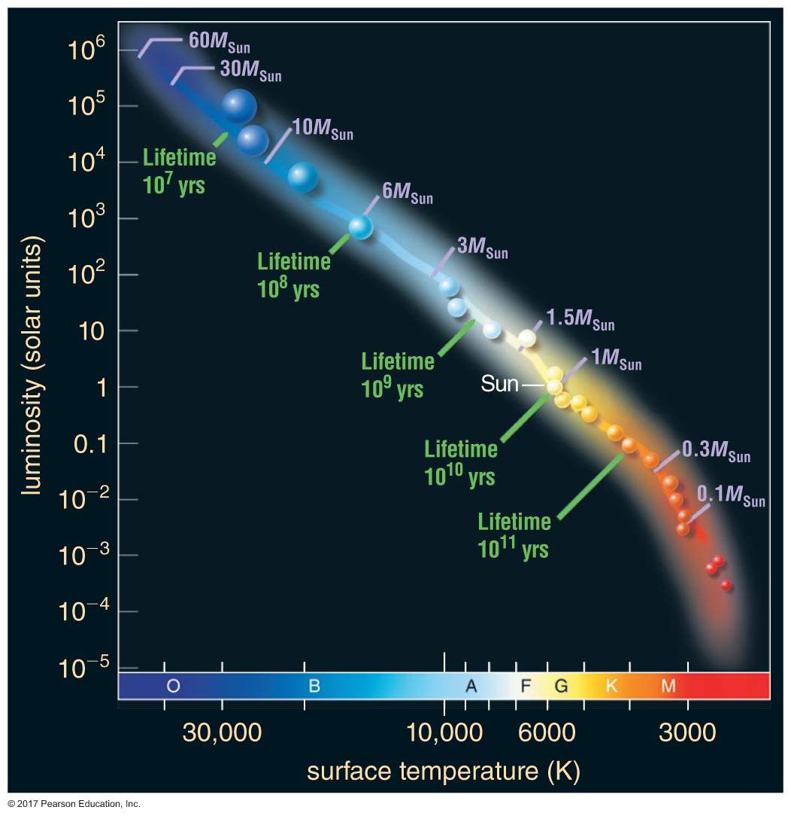
A quick recap: the Sun, leaving the main sequence
Fusing H into He: 10¹⁰ years
Fusion distributed throughout core, over time, inert He core grows
He produced sinks to middle, H now in temperature region < 10⁶ K!
Fusion slows, gravity starts to collapse core
Without energy input, surface starts to cool, redden
Notes:
Color gradient for the Sun is done deliberately to illustrate density and temperature changes from the center of the Sun (very hot, very dense) to the surface (cool, much less dense)

Slide 5
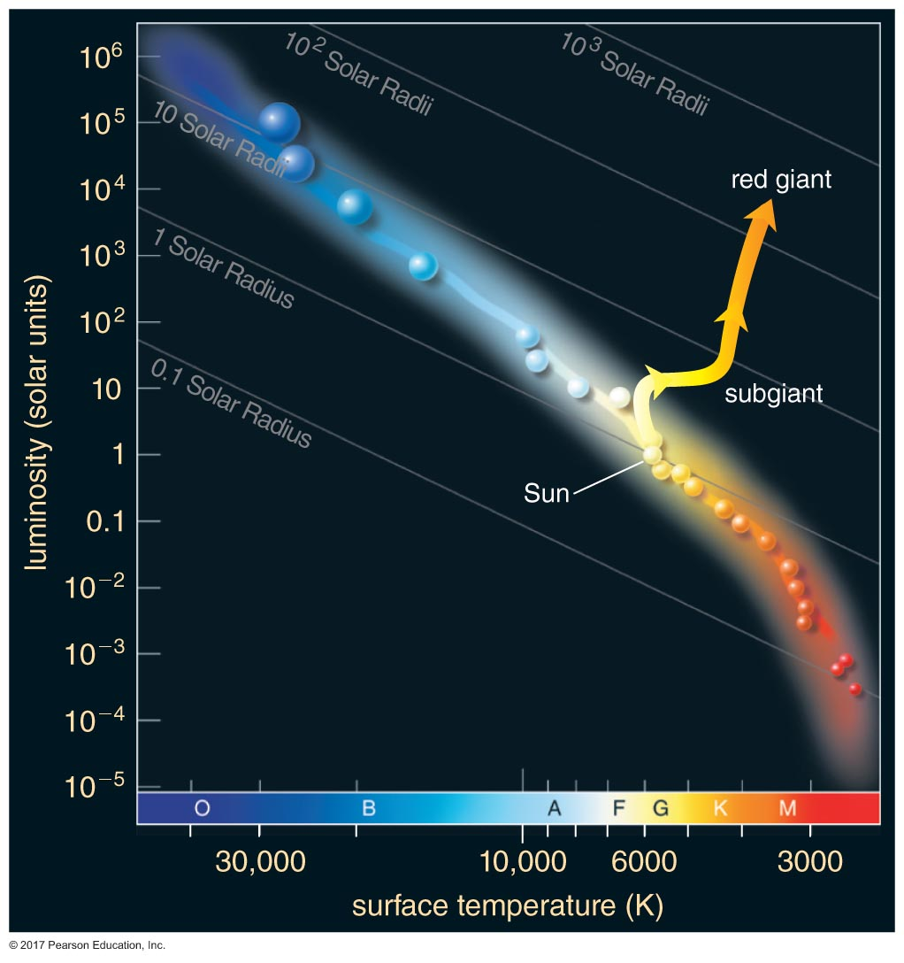
A quick recap: the Sun, leaving the main sequence
Temperature rises enough that H now in sweet spot to start fusing again
H shell fusion
H shell fusion supplies outward force: outer layers expand, He core is still contracting until degeneracy pressure stops it from contracting further
Stellar wind gets stronger
Notes:
Color gradient for the Sun is done deliberately to illustrate density and temperature changes from the center of the Sun (very hot, very dense) to the surface (cool, much less dense)

Slide 6
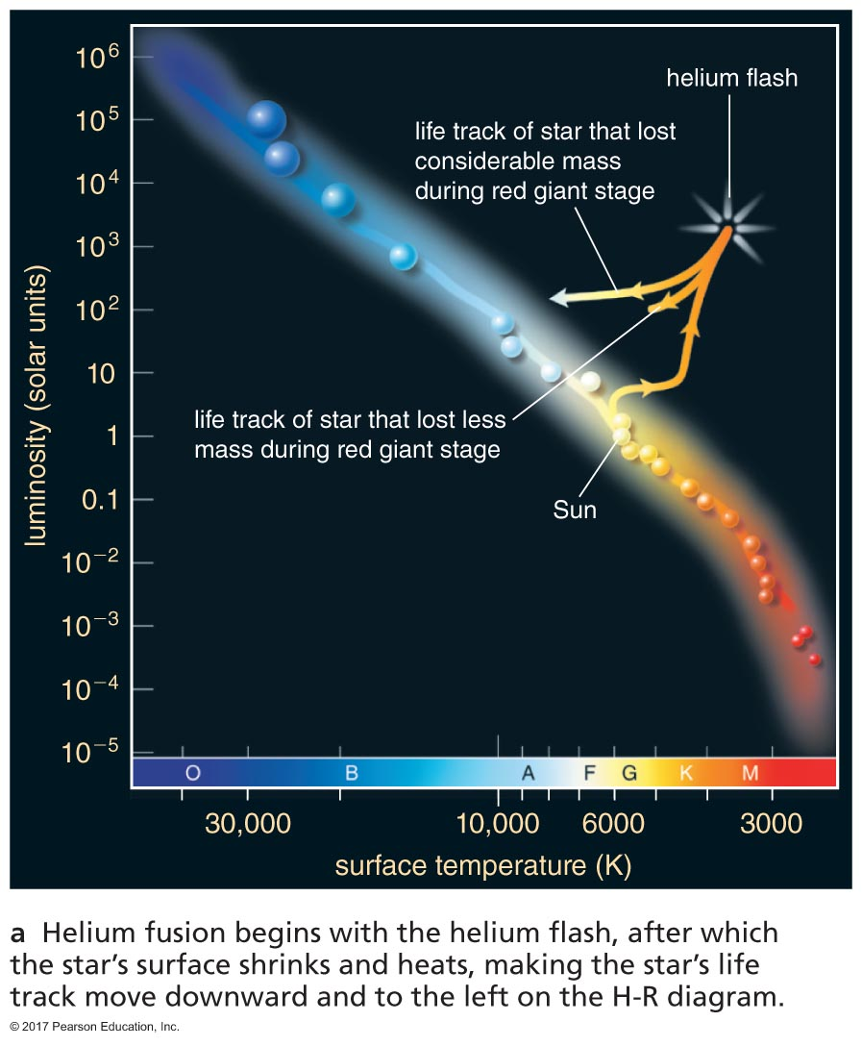
A quick recap: the Sun, leaving the main sequence
After ~10⁹ years…
Temperature continues rising until hot enough near inert He core for fusion to start
Core very dense—supported by degeneracy pressure
Helium starts to fuse into carbon with a flash
Radius decreases: He flash pushes H-fusing shell outward, it cools, fusion there slows. Surface gets warmer, less red
Notes:
Color gradient for the Sun is done deliberately to illustrate density and temperature changes from the center of the Sun (very hot, very dense) to the surface (cool, much less dense)

Slide 7
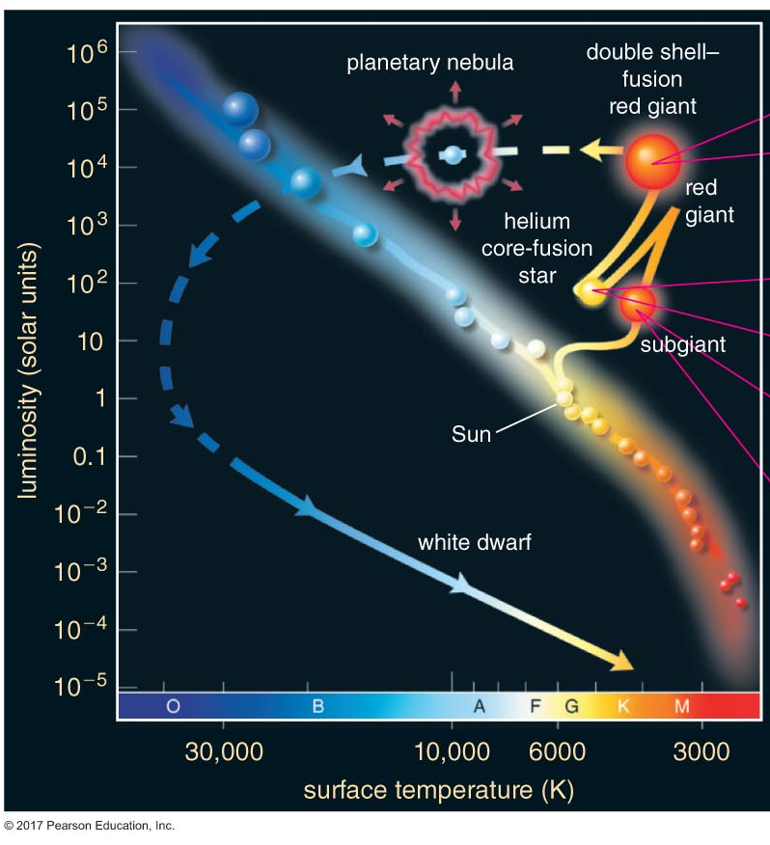
A quick recap: the Sun, leaving the main sequence
Inert C core, He-fusing shell, H-fusing shell
Expands and reddens again, in pulses: H- and He-fusing shells driving expansion, then cooling slows fusion rate, contraction
Pulsations dredge up C from core, it gets output into stellar wind; C+C makes dust
Notes:
Color gradient for the Sun is done deliberately to illustrate density and temperature changes from the center of the Sun (very hot, very dense) to the surface (cool, much less dense)

Slide 8
A quick recap: the Sun, leaving the main sequence
Inert C core, He-fusing shell, H-fusing shell
Expands and reddens again, in pulses: H- and He-fusing shells driving expansion, then cooling slows fusion rate, contraction
Pulsations dredge up C from core, it gets output into stellar wind; C+C makes dust
He burned into C in ~100 million years
Poof!
Notes:
Color gradient for the Sun is done deliberately to illustrate density and temperature changes from the center of the Sun (very hot, very dense) to the surface (cool, much less dense)

Slide 9
Planetary nebulae
Exposed carbon core left behind = white dwarf
White because it’s so hot! Used to be the core of the star, a lot of thermal energy remains
Carbon degeneracy pressure keeps core from collapsing further

Slide 10
Planetary nebulae
Through pulses and winds, outer layers of giant’s atmosphere are ejected
Called a planetary nebula (a terrible name..)
If encountering no resistance, atmosphere travels away from star (escapes), carrying on at its original velocity
For many stars, winds moving faster at the poles than the equator; their planetary nebulae can trace out this shape
Butterfly Nebula is one of the strangest planetary nebulae: did the disk block material from being ejected at star’s equator?
Notes:
https://www.esa.int/spaceinimages/Images/2014/10/Butterfly_death_throes

Slide 11
Planetary nebulae
Exposed carbon core left behind = white dwarf
White because it’s so hot! Used to be the core of the star, a lot of thermal energy remains
Carbon degeneracy pressure keeps core from collapsing further
White dwarf gradually radiates away thermal energy, growing ever dimmer with time
Nebula expands, no longer visible after ~100,000 years

Slide 12
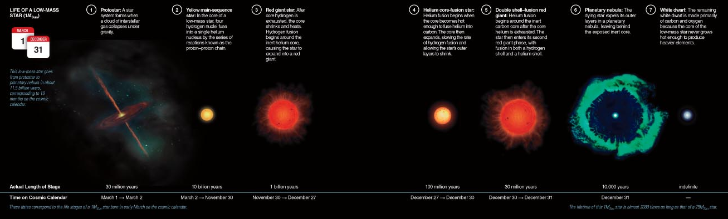
Timescales in context

Slide 13
Sooo.. Uh. Cool. What about us?
We are toast! In about a billion years, maybe
1-5 billion years from now: subtle increase in Sun’s luminosity will be enough to cause runaway greenhouse effect, make oceans boil
At 5 billion years from now, luminosity will have increased up to 1000x present just before helium flash. This will heat Earth to about 1000K
After another 100 million years, once helium core fusion ends, Sun’s surface will expand to about Earth’s orbit

Slide 14

Bummer.
Or is it?
Check out the Special Topic on page 543. Considering it took about 65 million years for humans to get to our present stature after dinosaurs’ extinction event, there are nearly 80 more 65 million year intervals between now and when the Sun will leave the main sequence!
Notes:
We have lots of time to figure out this whole solar red giant thing… great!

Slide 15
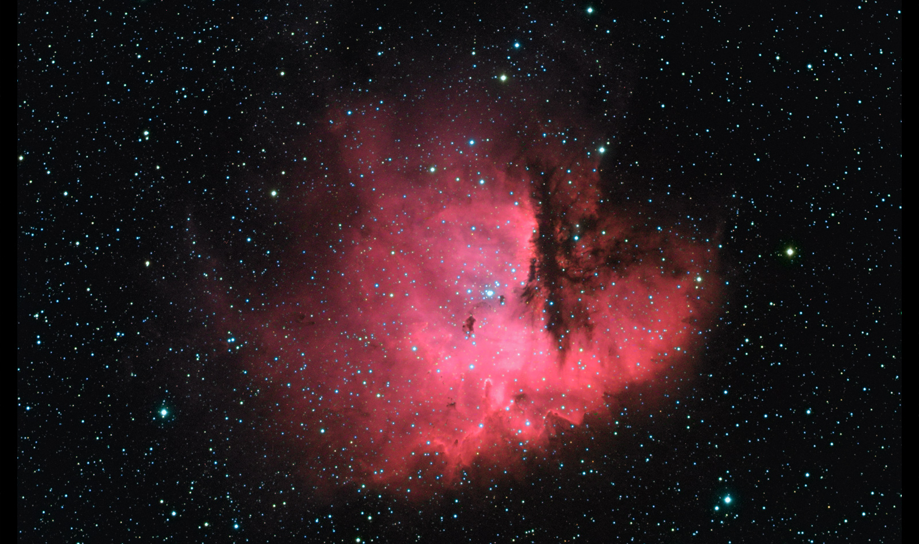
Life cycles of stars: high-mass stars
Chapter 17, The Cosmic Perspective

Slide 16
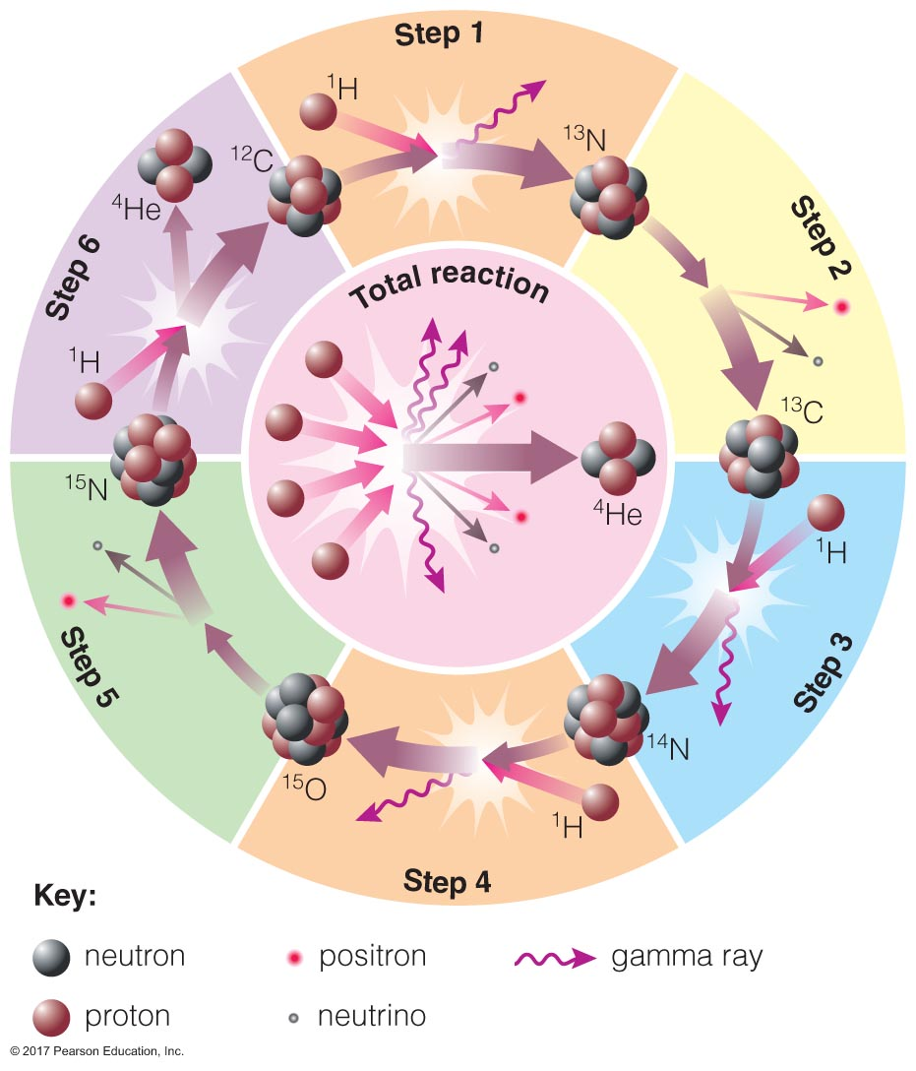
High-mass stars’ lives
Hotter and faster!
Instead of proton-proton chain fusion, high mass stars undergo the CNO cycle (Carbon, Nitrogen, Oxygen)
Protons slam into other protons, C, N, and O nuclei
End result is the same: production of He nuclei and energy release
Rate of fusion very high: more radiation pressure, stars have larger radii, higher luminosities, hotter surface temperatures

Slide 17
High mass stars’ lives
Radiation pressure drives fast stellar winds
Consider: If the mass loss rate is 10⁻⁵ M☉ per year, how long would it take for a 25 M☉ star to lose all of its mass in the wind?
25 M☉ = 2.5 million years
10⁻⁵ M☉ / year
Is this possible? No--runs out of fusion fuel first!
Notes:
https://apod.nasa.gov/apod/ap150623.html
Sharpless 308: Star Bubble Image Credit & Copyright: Kfir SimonExplanation: Blown by fast winds from a hot, massive star, this cosmic bubble is huge. Cataloged as Sharpless 2-308 it lies some 5,200 light-years away toward the constellation of the Big Dog (Canis Major) and covers slightly more of the sky than a Full Moon. That corresponds to a diameter of 60 light-years at its estimated distance. The massive star that created the bubble, a Wolf-Rayet star, is the bright one near the center of the nebula. Wolf-Rayet stars have over 20 times the mass of the Sun and are thought to be in a brief, pre-supernova phase of massive star evolution. Fast winds from this Wolf-Rayet star create the bubble-shaped nebula as they sweep up slower moving material from an earlier phase of evolution. The windblownnebula has an age of about 70,000 years. Relatively faint emission captured in the expansive image is dominated by the glow of ionized oxygen atoms mapped to a blue hue.

Slide 18
High mass stars’ lives
After a few million years, high mass stars run out of H in the core to fuse
H shell fusion begins; outer layers of star expand → supergiant
He fusion begins; not with a flash, but gradually
He fusion lasts a few 100,000 years
Contraction of inert C core begins, He shell fusion begins, H shell fusion continues
To this point, the story of low- and high-mass stars is about the same; just faster for higher mass stars

Slide 19
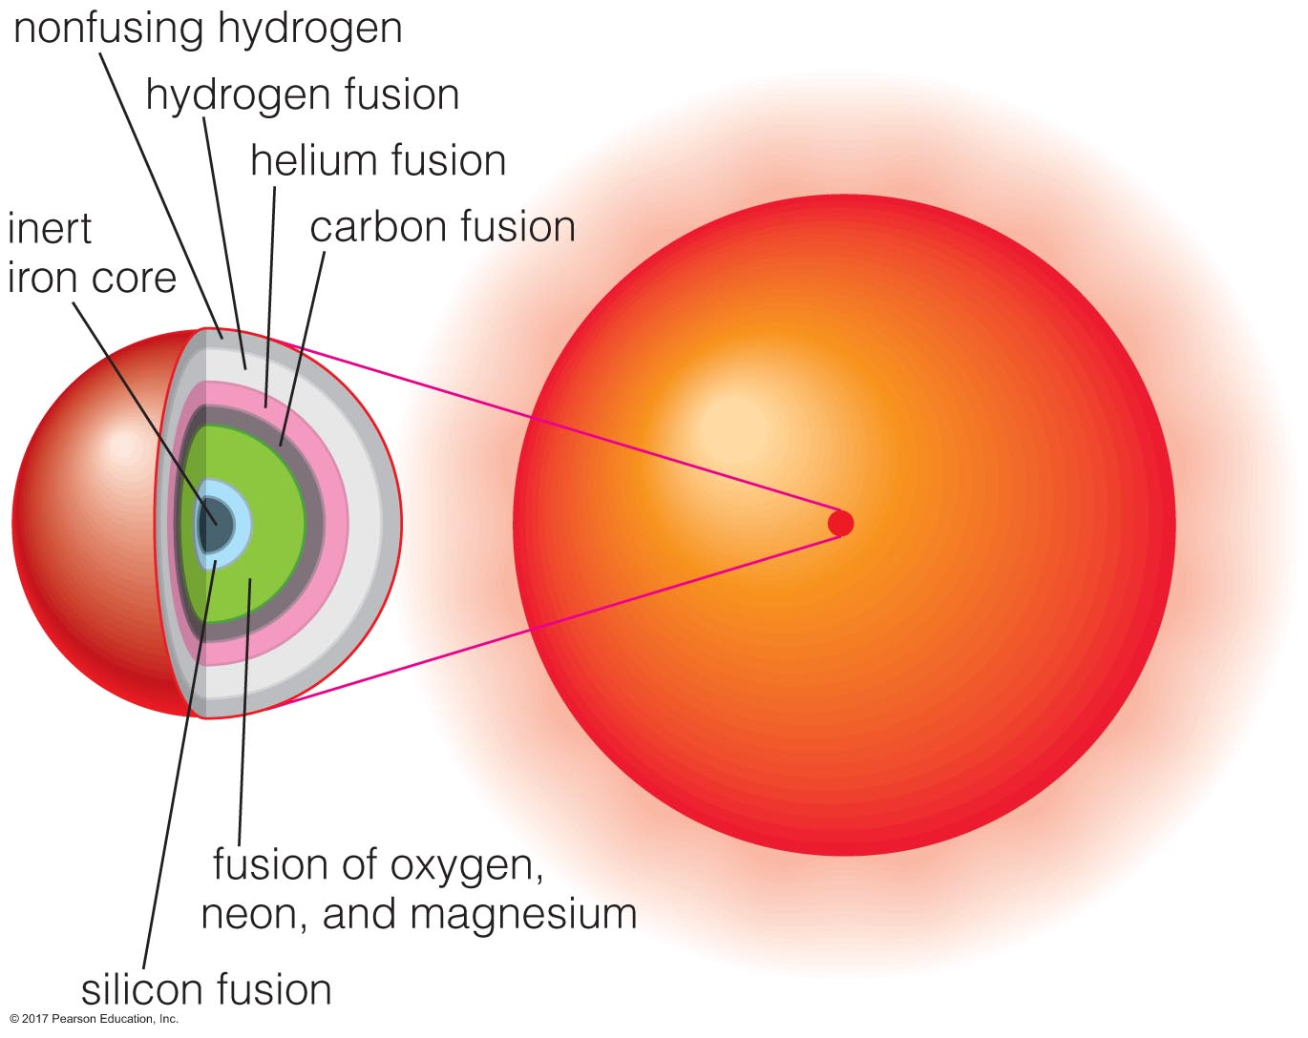
The core of a high-mass star
In the low mass star’s case, the core is too cool to fuse elements heavier than He, so collapse continues until Carbon’s degeneracy pressure prevails and halts collapse
In high-mass stars, temperatures are so high fusion continues: Carbon starts fusing at 600 million K
C fusion lasts just a few hundred years

Slide 20
The core of a high-mass star
Next, depending on temperature, more complex fusion begins
He-capture reactions:
C+He→O,
O+He→Ne
Ne+He→Mg
Heavy nuclei start fusing:
C+O→Si
O+O→S
Si+Si→Fe
Some of these reactions create neutrons that can fuse with heavy elements to produce even rarer elements
Fusion proceeds in shells until iron starts to pile up in the star’s core; it does not fuse

Slide 21
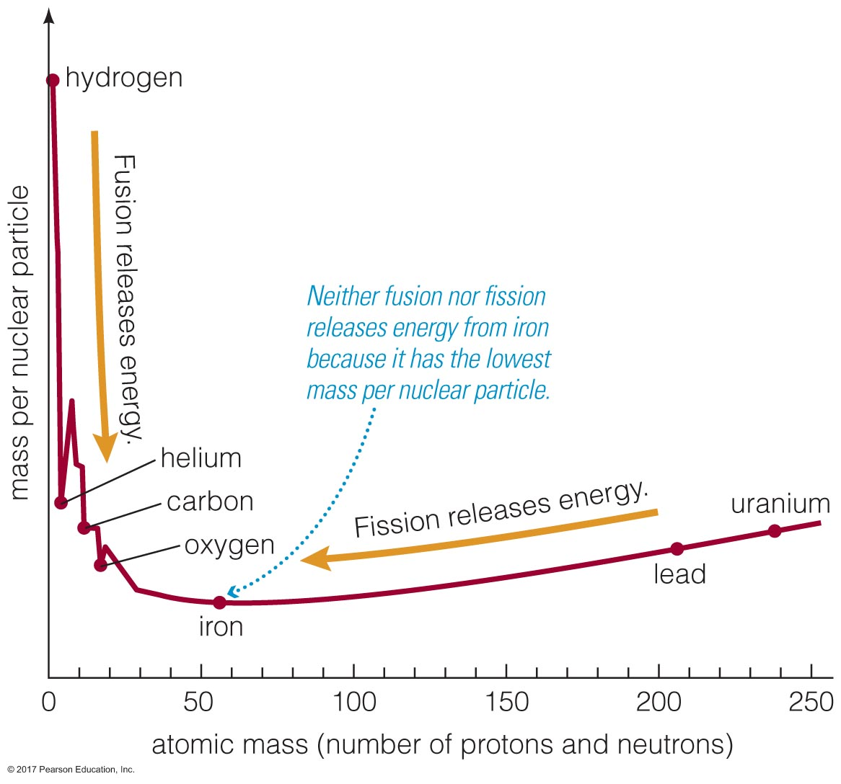
It’s elemental
In fusion, the nucleus produced is less massive than the nuclei that collided to produce it
‘missing’ mass is converted to energy:
some of this energy radiates away,
some energy goes into motion of new nucleus, and
some goes into binding the new nucleus together
Iron has the lowest mass per nuclear particle of all the elements. It can be produced by fusion or fission, but itself cannot fuse or … fizz (non-technical term)
Anything heavier than iron takes energy to produce, rather than producing energy
Notes:
Fission is the verb for when an atom undergoes fission. So I could have said “Iron can be produced by fission, but cannot itself fission.” Fizz is funnier.

Slide 22
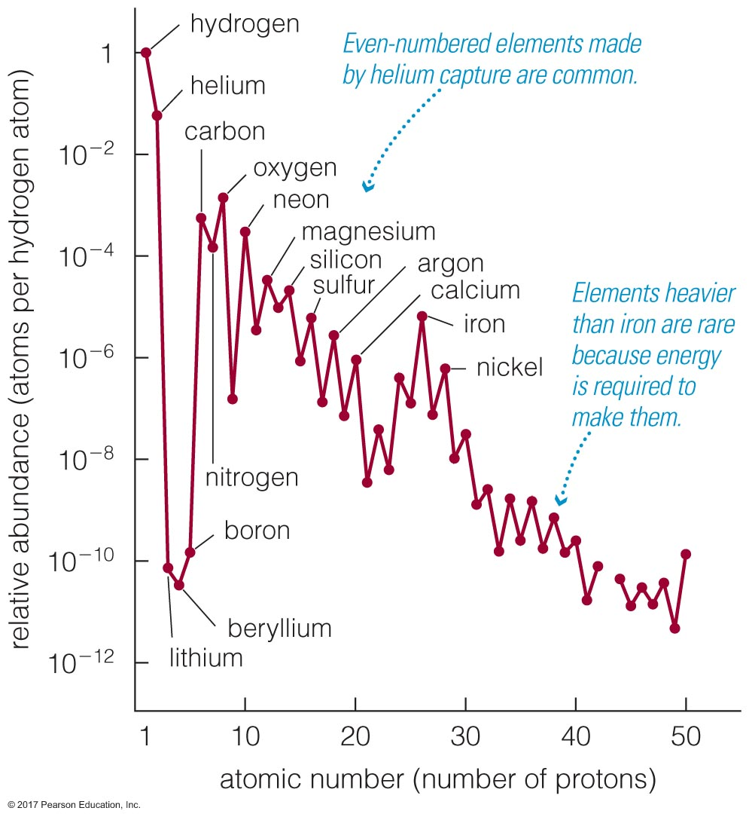
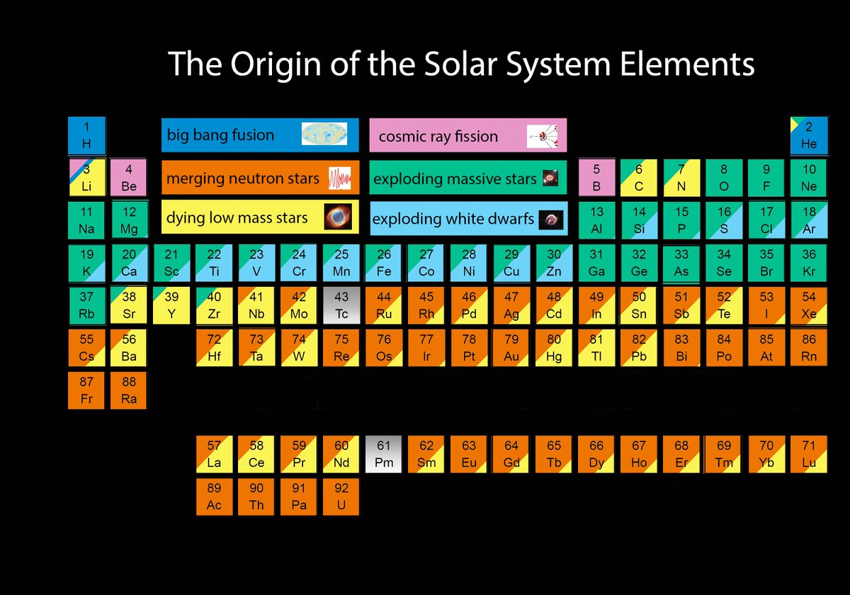
It’s elemental: we are made of star-stuff!
How do we know what we know?
Big Bang produced H, He, tiny bit of Li
Even-numbered elements more abundant
Stars in (older) globular clusters have ~0.1% metals by mass; (young) open-cluster stars have 2-3%
Notes:
https://twitter.com/jajohnson51/status/816827622369935362

Slide 23
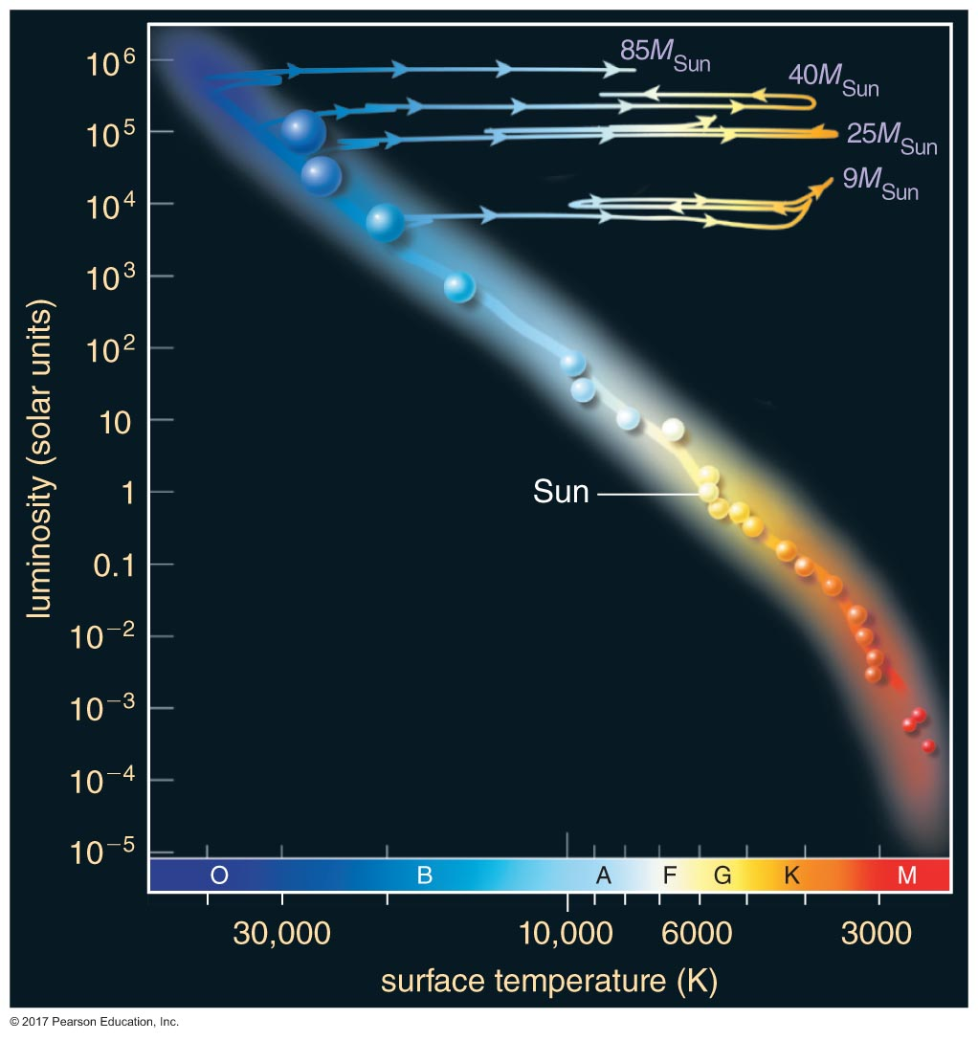
What happens to the high-mass star next?
Depends on its mass!
In the core of a star, no matter its mass, Fe won’t fuse into anything heavier. The last few days of a high-mass star’s life are due to electron degeneracy pressure of iron holding out against collapse
…until it can’t any more

Slide 24
What happens to the high-mass star next?
At high enough pressure, even electron degeneracy pressure can’t hold out: electrons combine with protons to form neutrons, collapse continues, catastrophically
Imagine the mass of the Sun, all neutrons, starting at about Earth’s size collapsing down to about the size of Greensboro
Huge amounts of gravitational potential energy released in collapse, blows off star’s remaining outer layers: supernova!
Notes:
http://hubblesite.org/image/755/news_release/1999-04
Glittering stars and wisps of gas create a breathtaking backdrop for the self-destruction of a massive star, called supernova 1987A, in the Large Magellanic Cloud, a nearby galaxy. Astronomers in the Southern hemisphere witnessed the brilliant explosion of this star on Feb. 23, 1987.
Shown in this NASA Hubble Space Telescope image, the supernova remnant, surrounded by inner and outer rings of material, is set in a forest of ethereal, diffuse clouds of gas. This three-color image is composed of several pictures of the supernova and its neighboring region taken with the Wide Field and Planetary Camera 2 in Sept. 1994, Feb. 1996 and July 1997.
The many bright blue stars nearby the supernova are massive stars, each more than six times heftier than our Sun. They are members of the same generation of stars as the star that went supernova about 12 million years ago. The presence of bright gas clouds is another sign of the youth of this region, which still appears to be a fertile breeding ground for new stars.
In a few years the supernova's fast moving material will sweep the inner ring with full force, heating and exciting its gas, and will produce a new series of cosmic fireworks that will offer a striking view for more than a decade.

Slide 25
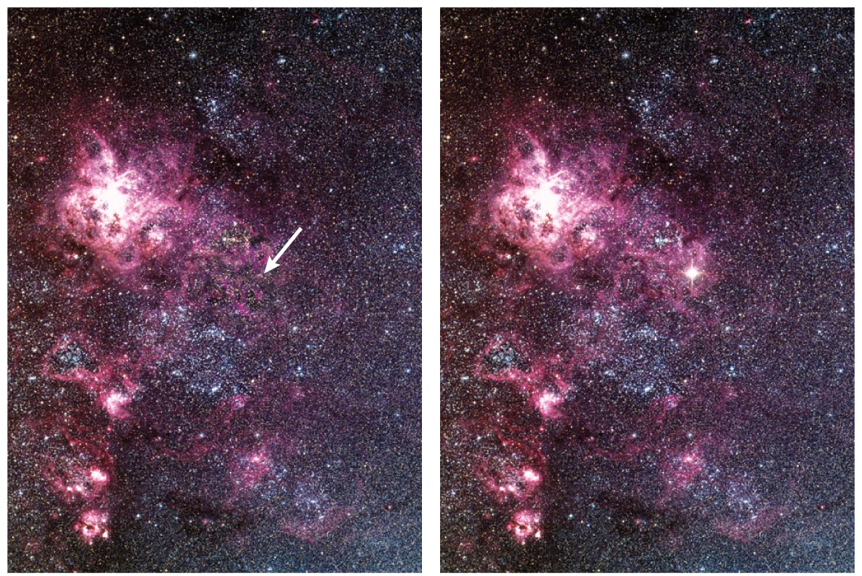
Supernova
We don’t know what exactly happens inside the star, but it could be…
Material collapses onto neutron core, core slightly bounces, accelerating material away
When the core implodes, electrons combining with protons produces SO MANY NEUTRINOS! They could add energy to the shock wave and help propel atmosphere away
In the core collapse/shock/bouncing back/ejecting of the star’s atmosphere, enough energy is produced to fuse heavier elements than iron (neutrons were produced when core collapsed)
These elements are scattered off into space
Notes:
A burst of neutrinos was observed with 1987A was discovered, confirming theories on what happens when a star goes supernova

Slide 26
Supernova remnants
Notes:
Supernova remnants

Slide 27
What happens to even higher-mass stars?
Neutron degeneracy pressure is left to fight gravity
More on neutron stars next class…
If there’s enough mass left, it too can be overcome: a black hole forms
More on black holes next class!!
Notes:
Just in case you aren’t a chapter ahead in your reading… the bizarre stellar graveyard is coming up just in time for halloween!

Slide 28
Stars don’t all live in isolation…
What if stars are in binaries?
And close enough to tidally interact?
And close enough to exchange mass?
Could impact stars’ lifetimes!
Algol system: 3.7M☉ main-sequence star + 0.8M☉ subgiant
(think about why this is weird, if we assume binary stars formed together and are the same age)

Slide 29
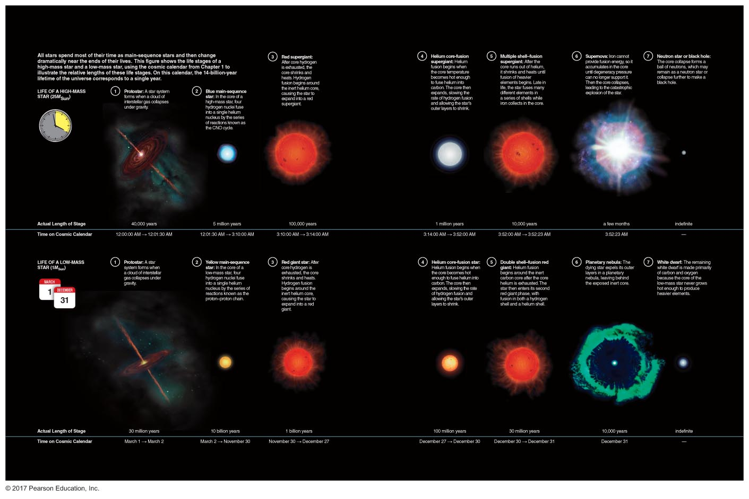
Summary
Notes:
To compare life cycles of high and low-mass stars…

